Slide 1
MISQ Paper Revision Plan
Dylan Junluo CHEN, Ben LIU, Xin LI

Slide 2
Outline
Summary of our paper (page 2~4)
Review panel’s major concern (page 5)
SE’s suggestion (page 6)
Our plan

Slide 3


Background
Online Q&A Communities
Supply
Internal GenAI
Supply
Supply
Questions
Answers
Questioners
Answerers
Our Research Question:
How does internal GenAI affect human answerers (supply) and viewers (recognition) in online Q&A communities?
External GenAI
(e.g., ChatGPT)

Slide 4
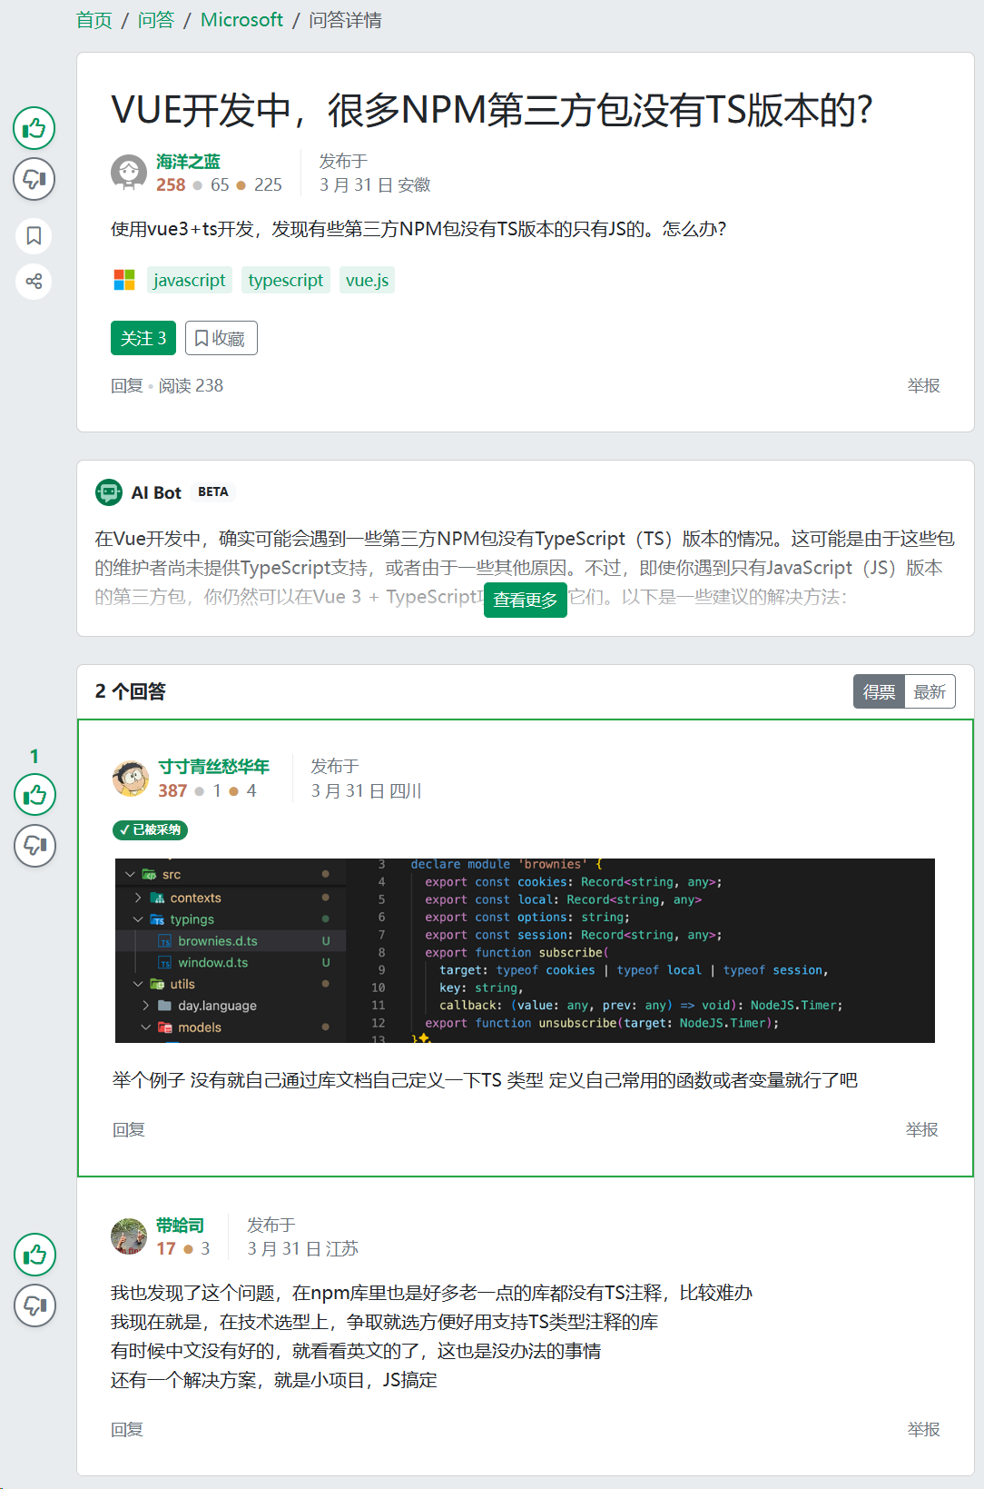
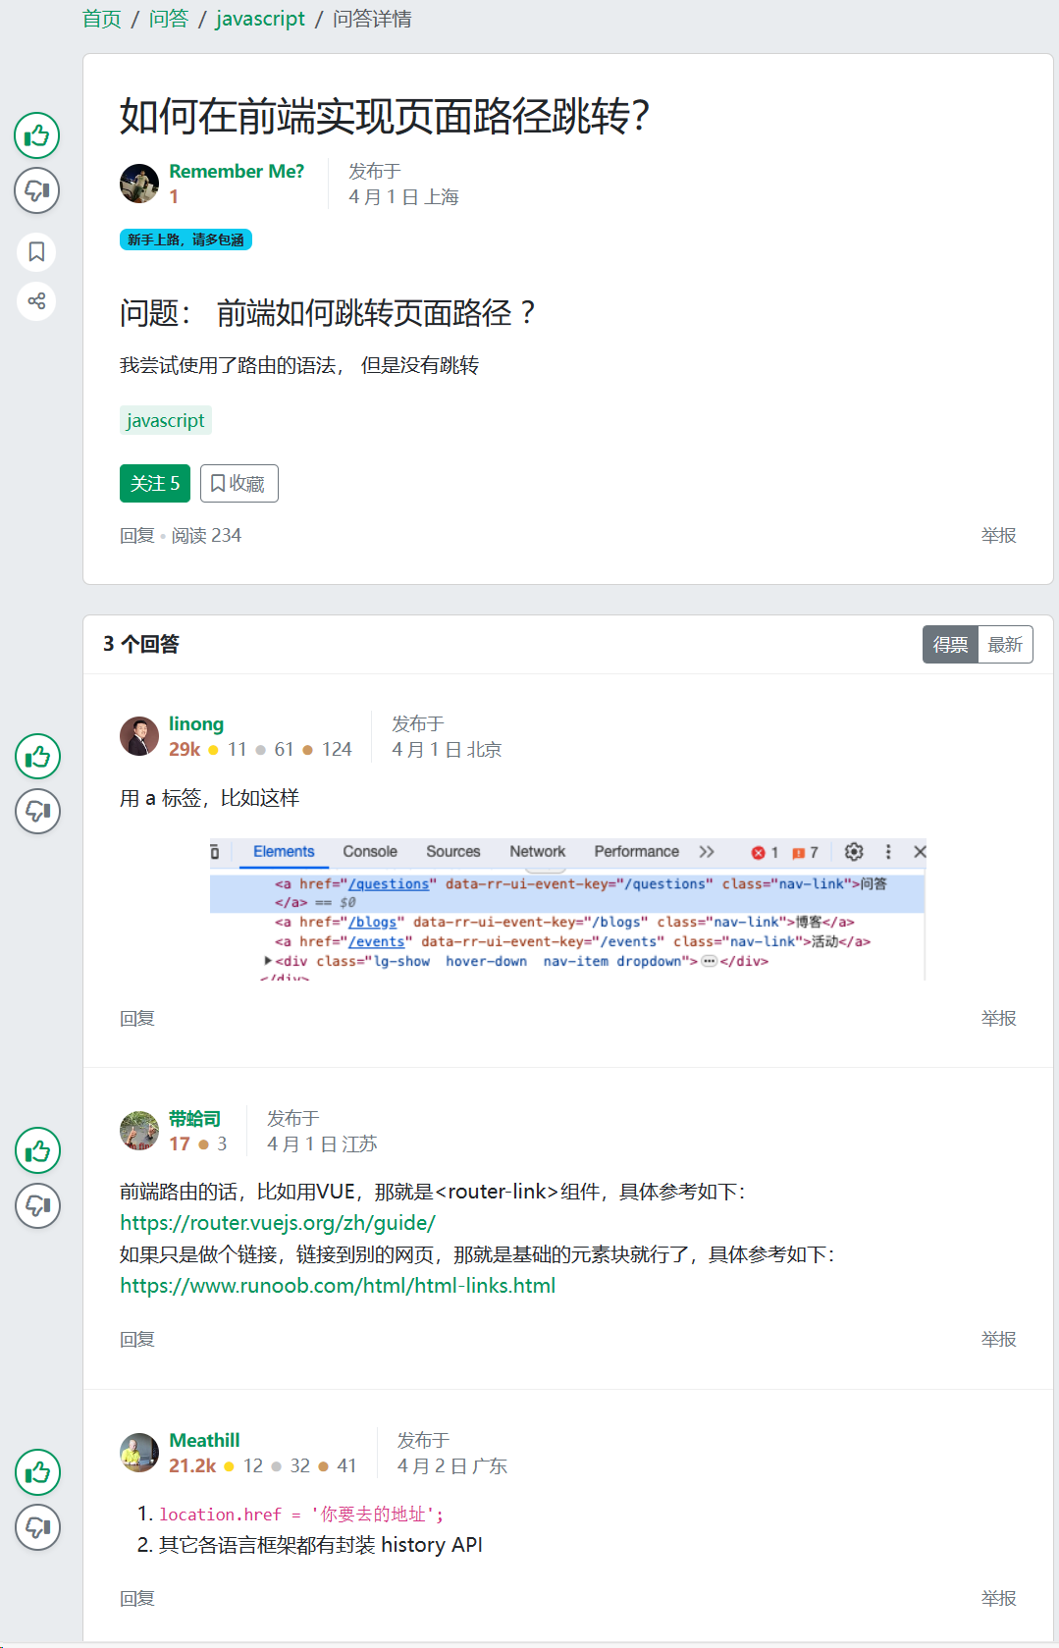
A Randomized Field Experiment on SegmentFault
AI group (treatment group)
no AI group (control group)

Slide 5
Original Framing (not drawn in the paper)
mechanisms
Source Effect
Answerer Participation
Content Effect
(-)
Position Effect
Has AI Answer
Quality Degradation
(-)
Viewer Recognition
Attention Diversion
Elevated Expectations

Slide 6
Review panel’s major concerns
Lacks a sufficiently convincing theoretical explanation
1. lacks an overarching theoretical framework explaining
2. Original 3 mechanism (source, content, and position)
R2: theoretically justified?
R3: they are introduced largely in isolation
3. relationship between theory and empirical findings
Difference from Su et al. (2023)
Su, Y., Zhang, K., Wang, Q., & Qiu, L. (2023). Generative AI and Human Knowledge Sharing: Evidence from a Natural Experiment. SSRN Scholarly Paper.

Slide 7
SE’s suggestions
participation incentives in online knowledge communities.
authority and credibility signals in human–AI interaction
examining competition and complementarity between AI-generated and human-generated knowledge in digital communities
Such a framing could help explain when AI discourages human participation and when it might instead stimulate additional contributions.
Our pick √

Slide 8
Revise of the Focus of the Paper
Source Effect
Reasons:
Difficult to identify (R1, R2, R3)
It is difficult for reviewers to understand (R2)
Answerer Participation
Content Effect
(-)
Position Effect
Has AI Answer
Quality Degradation
Reason:
To move from empirical regularities to explaining the behavioral processes (SE), we switch our focus
(-)
Viewer Recognition
Attention Diversion
Elevated Expectations

Slide 9
New framework
Answerer Participation
Has AI Answer
Answer Quality
AI Answer Length
AI Answer Quality
Fast Processing
Slow Processing

Slide 10
New framework: What’s difference?
Previous Version
New Revision
Previous
Core DV
Answerer Participation
Has AI Answer
Previous Source Effect
New DV
Answer Quality
Previous Content Effect
AI Answer Length
AI Answer Quality
Questioned By Reviewer
Fast Processing
Slow Processing

Slide 11
AI’s Two Roles in Competition with Human
Answerer Participation
Humans view AI as a weaker competitor
Has AI Answer
Answer Quality
AI content generate concrete competition
AI Answer Length
AI Answer Quality
Fast Processing
Slow Processing

Slide 12
Two Different Content Signals for Two Decisions
Based on Kahneman (2011)
Answers make two decisions
1) whether to participate
2) how to contribute
Participation is a fast decision which relies on fast signals, such as length
Contribution is a slow decision which relies on slow signals, such as quality
Answerer Participation
Has AI Answer
Answer Quality
AI Answer Length
AI Answer Quality
Fast Processing
Slow Processing
Kahneman, D. (2011). Thinking, fast and slow. Farrar, Straus and Giroux.

Slide 13
Theoretical Development: Competition with a "Weaker" Competitor
Core Logic:
Humans view AI as a weaker competitor (without seeing content),
yet AI content triggers strong competitive dynamics that deter human contributions and elevate human answer quality.
DV: | Contribution (Fast) | Answer Quality (Slow)
AI Presence (as a weaker competitor) | H1: ↑ (easy win → motivates entry) | H3: ↓ (weak rival → complacency)
Moderated by Length | H2: attenuates H1 (occupied space → deters entry) | —
Moderated by Quality | — | H4: reverses H3 (credible rival → raises the bar)

Slide 14
Our new main results
 | (1) | (2) | (3) | (4)
DV: | log of the number of human answers provided within 7 days (answerNumi) |  | first human answer quality (human1SimWithLLMi)
AI_{i} | -0.046 *** | 0.226 ** | 0.000 | -0.120 .
 | (0.011) | (0.085) | (0.007) | (0.067)
AI_{i} * AILength_{i} |  | -0.045 ** |  | -0.013
 |  | (0.014) |  | (0.011)
AI_{i} * AISimWithLLM_{i} |  | -0.038 |  | 0.350 ***
 |  | (0.051) |  | (0.034)
question controls | √ | √ | √ | √
questioner controls | √ | √ | √ | √
question timing FE | √ | √ | √ | √
N | 3,613 | 3,603 | 2,685 | 2,685

Slide 15
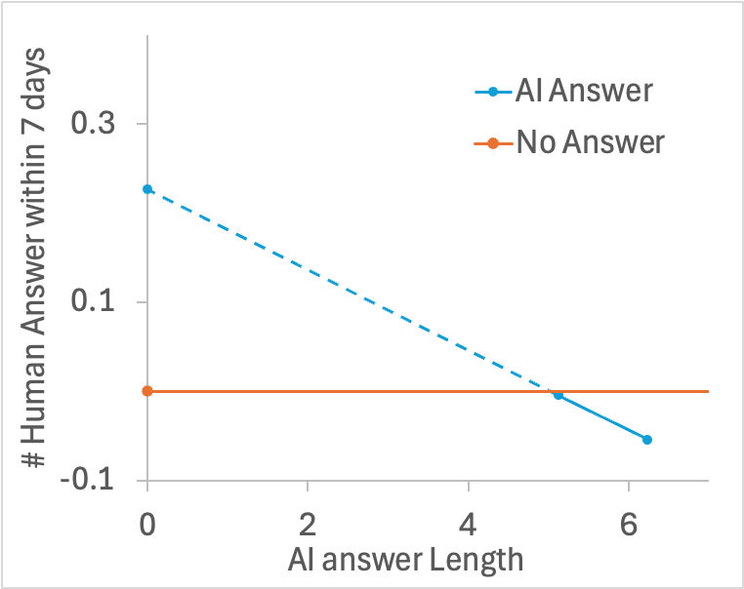
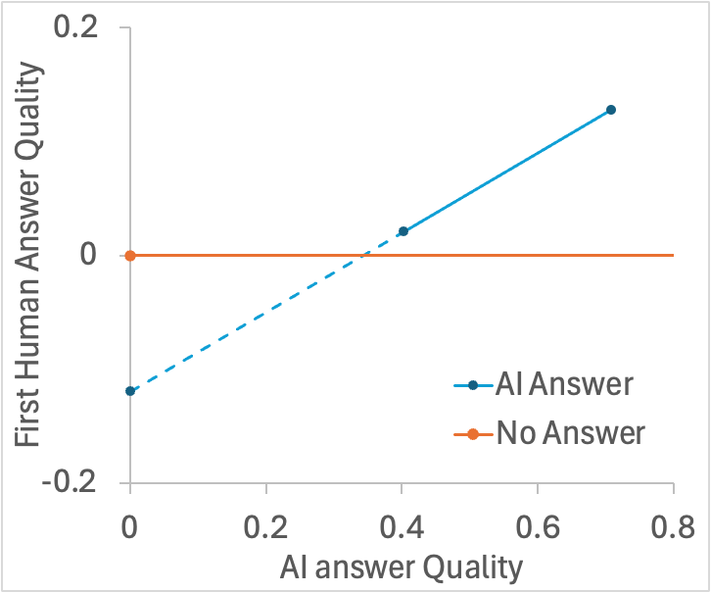
Our new main results (interaction plot)
AI deter human contribution when answer is lengthy
AI elevate human answer quality when answer is high-quality

Slide 16
Inclusion of Prior Findings (Su et. al)
Su et al. (2023)
AI encourage contribution
Our findings in last round:
AI deter contribution
True reason:
Content deter contribution; Label encourage contribution

Slide 17
Competition Effect on Contribution (Fast Processing — Length as Signal)
Has AI Answer
Answerer Participation
AI Answer Length
H1: AI presence increases human contribution.
Humans perceive AI as a “weak” competitor (because of competitive arousal – experts believe SegmentFault is their expert-specific area)
Regardless of AI answer length or quality, the competitive trigger stimulates a baseline impulse to respond.
H2: The competitive crowding-out is stronger when the AI answer is longer.
Length is a fast-processed heuristic for how “comprehensive" the competitive space is.
A longer AI answer signals a more formidable competitive barrier → the "easy win" perception erodes → the baseline positive contribution effect is attenuated or reversed.

Slide 18
Competition Effect on Answer Quality (Slow Processing — Quality as Benchmark)
Has AI Answer
Answer Quality
AI Answer Quality
H3: AI presence decreases human answer quality.
Facing a perceived weaker competitor, humans become complacent → reduced effort investment → "I don't need to try hard to beat this" → lower quality.
Regardless of AI answer length or quality, the baseline competitive posture toward a "weak" rival lowers the quality bar humans set for themselves.
H4: The negative quality effect reverses when AI answer quality is high.
High AI quality can only be assessed through slow, deliberate processing → once recognized, it shatters the "weak competitor" assumption.
A high-quality AI answer serves as a visible benchmark to surpass → triggers genuine competitive effort → humans invest more to demonstrate superiority → quality rises.
"The AI is actually good — I must prove I'm better."

Slide 19
Appendix

Slide 20
Broader Platform Engagement: Effects of AI-Generated Answers on Questioner Activity and Question Visibility
 | (1) | (2) | (3) | (4) | (5)
DV: | the logarithm of the number of questioner’s subsequent activities after receiving an answer in |  |  | DV: the logarithm of the number of comments the questioner posted in response to answers received by question i (Comment_{i}) | DV: the logarithm of the cumulative viewership count for question i (View_{i})
 | 1 month | 2 months | 3 months
AI_{i} | -0.010 | -0.002 | -0.009 | -0.039 | -0.009
 | (0.027) | (0.030) | (0.030) | (0.020) | (0.016)
question timing FE | √ | √ | √ | √ | √
other controls | √ | √ | √ | √ | √
N | 3,613 | 3,613 | 3,613 | 2,748 | 3,613

